Slide 1
Palo Alto Networks
Markus Laaksonen
mlaaksonen@paloaltonetworks.com

Slide 2




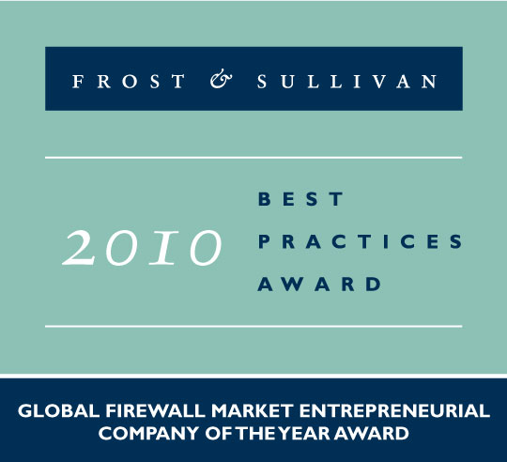


About Palo Alto Networks
Palo Alto Networks is the Network Security Company
World-class team with strong security and networking experience
  Founded in 2005 by security visionary Nir Zuk
  Top-tier investors
Builds next-generation firewalls that identify / control 1200+ applications
  Restores the firewall as the core of the enterprise network security infrastructure
  Innovations: App-ID™, User-ID™, Content-ID™
Global footprint: 3,500+ customers in 70+ countries, 24/7 support

Slide 3
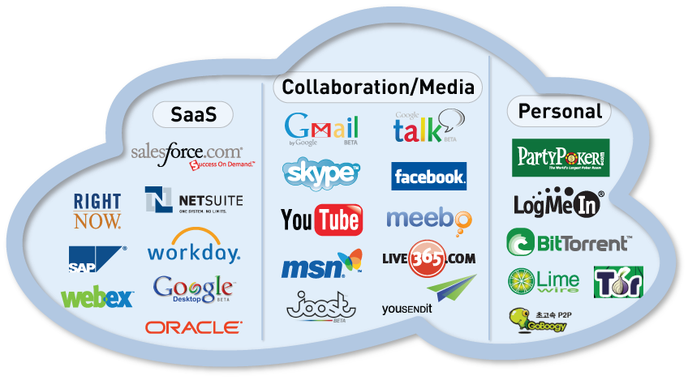
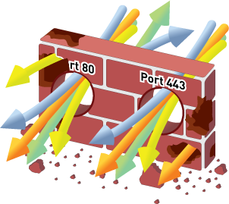
Applications Have Changed; Firewalls Have Not
The gateway at the trust
border is the right place to
enforce policy control
Sees all traffic
Defines trust boundary
BUT…applications have changed
Ports ≠ Applications
IP Addresses ≠ Users
Packets ≠ Content
Need to restore visibility and control in the firewall

Slide 4
Enterprise 2.0 Applications and Risks Widespread
Palo Alto Networks’ latest Application Usage & Risk Report highlights actual behavior of 1M+ users in +1200 organizations
  Enterprise 2.0 applications continue to rise for both personal and business use.
  Tunneling and port hopping are common
  Bottom line: all had firewalls, most had IPS, proxies, & URL filtering – but none of these organizations could control what applications ran on their networks

Slide 5
Sharing: Browser-based Sharing Grows
Fileshareing Trend: Frequency of use and number of applications shifts towards browser-based, coming from P2P
Use of other filesharing applications (like FTP) remains steady
80 filesharing applications (23 P2P, 49 BB, 9 other) consuming 323 TB (24%)
Xunlei, 5th most popular P2P consumed 203 TB – 15% of overall BW
Business benefits: easier to move large files, central source of Linux binaries
Outbound risks: Data loss is the primary business risk
Inbound risks: Mariposa is propagated across P2P (and MSN)

Slide 6
Browser-based Filesharing: The Next P2P?
Excluding Xunlei, browser-based filesharing bandwidth is nearly 50% of P2P (22 TB vs 48 TB)
Several distinct use cases emerging
  Part of infrastructure: Box.Net
  Help get the job done: DocStoc, YouSendIt!
  Mass sharing for dummies: MegaUpload, MediaFire, RapidShare

Slide 7
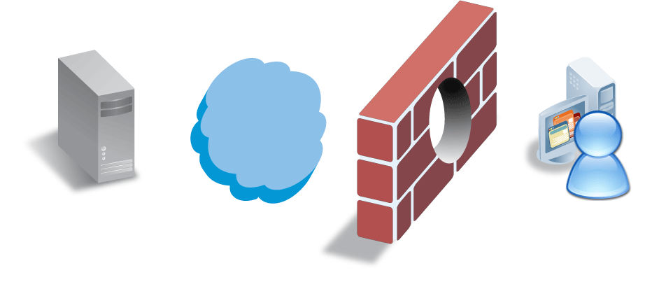
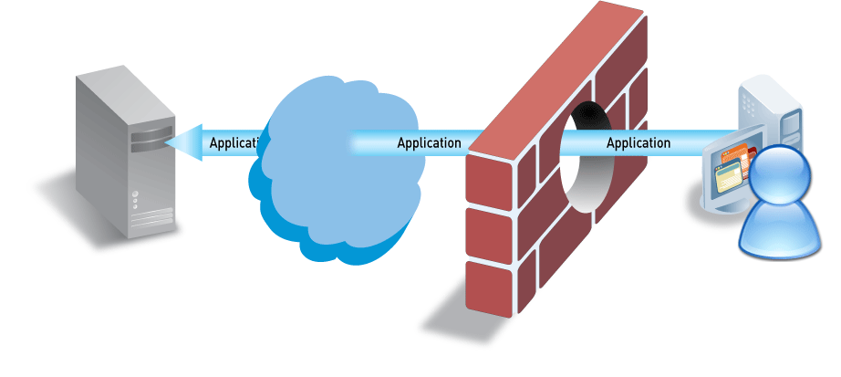
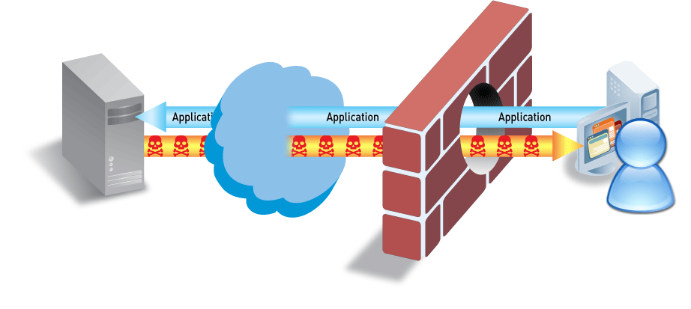
Applications Carry Risk
Applications can be “threats”
  P2P file sharing, tunneling applications, anonymizers, media/video
Applications carry threats
  SANS Top 20 Threats – majority are application-level threats
  Applications & application-level threats result in major breaches – Pfizer, VA, US Army

Slide 8
What the Stateful Firewall doesn’t see
Port hopping or port agnostic applications
  They don’t care on what port they flow
  The firewall can’t distinguish between legitimate or inappropriate use of the port/protocol
  The firewall can’t control the application
Tunneled applications (= evasion)
  A tunnel is built through an open port
  The real application is hidden in the tunnel
  It doesn’t even need to be an encrypted tunnel

Slide 9
The Business Problem
Web 2.0 or Enterprise 2.0 applications
  Use all the same port (80, 443)
  Some have business value, others don’t
The Stateful firewall can’t recognize them
  Only differentiator is the 5 tuple
    Source IP and port
    Destination IP and port
    Protocol

Slide 10
The Business Problem
As a result, there’s no control
  On the use of the application
    By the right user
      Only unidentified IP addresses are seen
    The legitimate application function
      Only the protocol/port is seen
  Application control can’t be implemented based on
    Function
      Maybe you want to allow WebEx, but not WebEx file and desktop sharing?
    QoS
      You can’t do that on port 80 or 443
    Routing
      Like regular web browsing should use a cheap DSL connection

Slide 11
The Firewall helpers
In order to address the shortcomings, enterprises have been adding firewall helpers in their network
  IPS
    To detect threats as well to block unwanted applications
  Proxy with or without a Web Filter
    To control web access, but only on standard ports
  Network AV
    To scan and prevent malware infections
  IM, QoS, …
    To address remaining issues

Slide 12


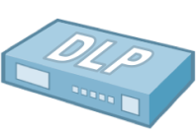







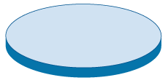

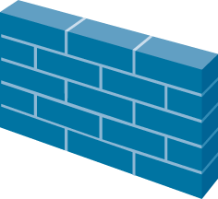
Technology Sprawl & Creep Are Not The Answer
Internet
“More stuff” doesn’t solve the problem
Firewall “helpers” have limited view of traffic
Complex and costly to buy and maintain
Putting all of this in the same box is just slow

Slide 13
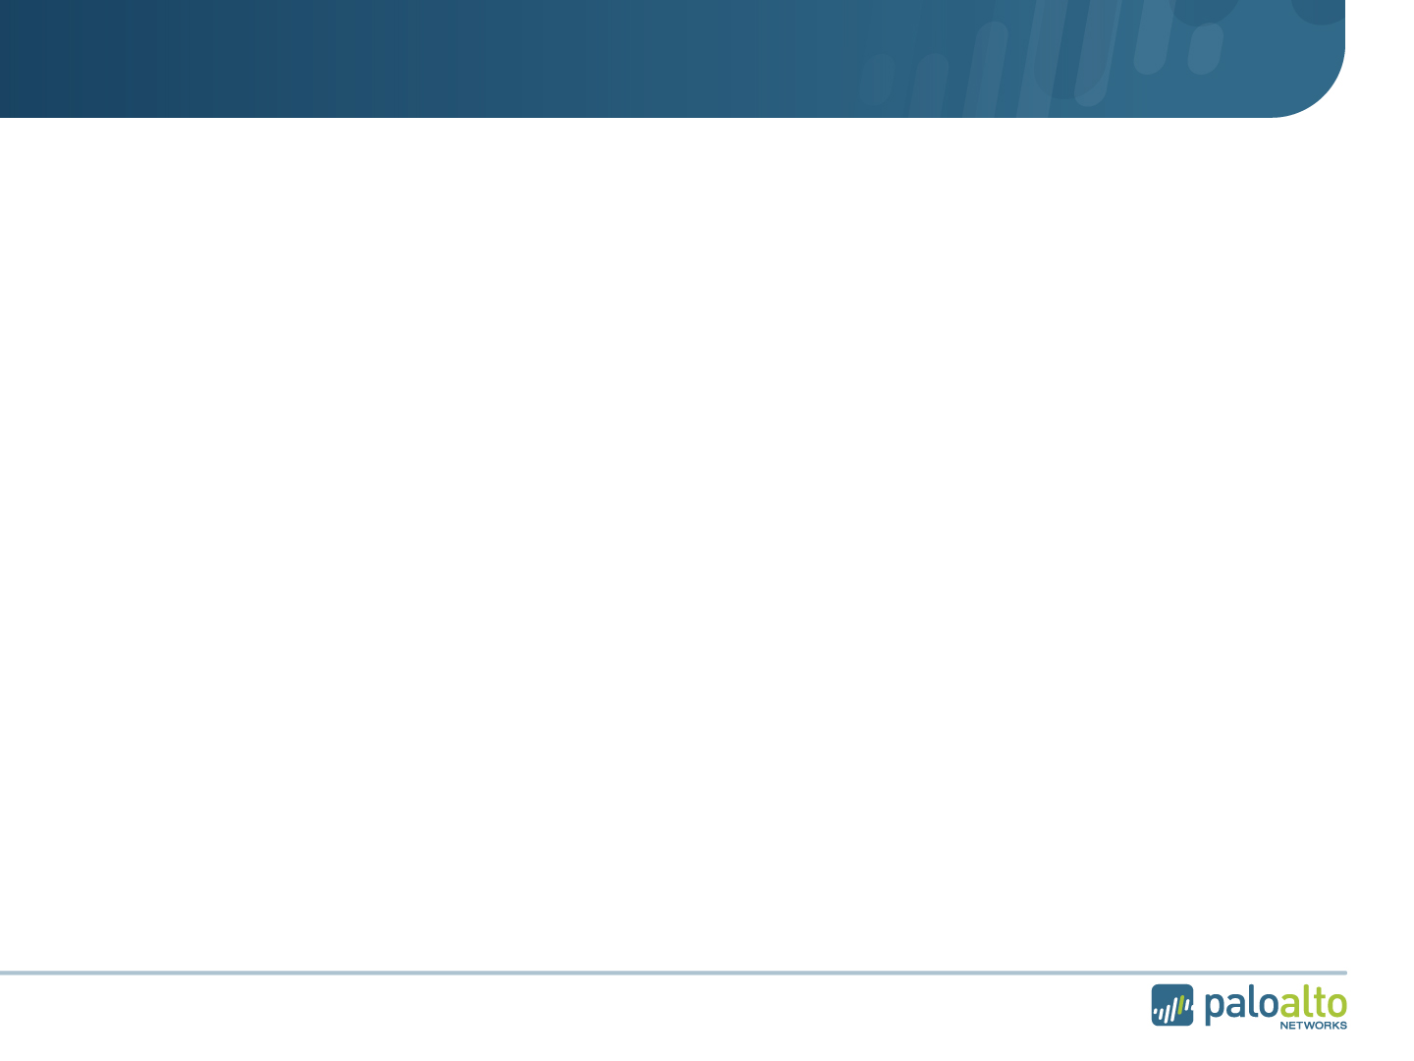
Traditional Multi-Pass Architectures are Slow
IPS Policy
AV Policy
URL Filtering Policy
IPS Signatures
AV Signatures
Firewall Policy
HTTP Decoder
IPS Decoder
AV Decoder & Proxy
Port/Protocol-based ID
Port/Protocol-based ID
Port/Protocol-based ID
Port/Protocol-based ID
L2/L3 Networking, HA, Config Management, Reporting
L2/L3 Networking, HA, Config Management, Reporting
L2/L3 Networking, HA, Config Management, Reporting
L2/L3 Networking, HA, Config Management, Reporting

Slide 14
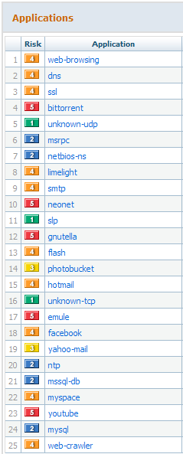
Traditional Systems Have Limited Understanding
Some port-based apps caught by firewalls (if they behave!!!)
Some web-based apps caught by URL filtering or proxy
Some evasive apps caught by an IPS
None give a comprehensive view of what is going on in the network

Slide 15
Why It Has To Be The Firewall
Path of least resistance - build it with legacy security boxes
Applications = threats
Can only see what you expressly look for
Firewall
IPS
Applications
Most difficult path - can’t be built with legacy security boxes
Applications = applications, threats = threats
Can see everything
Firewall
IPS
Applications
  Traffic decision is made at the firewall
  No application knowledge = bad decision
Notes:
15

Slide 16























What You See…with non-firewalls
What You See with With A Firewall

Slide 17



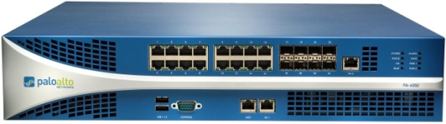

The Right Answer: Make the Firewall Do Its Job
New Requirements for the Firewall
1. Identify applications regardless of port, protocol, evasive tactic or SSL
2. Identify users regardless of IP address
3. Protect in real-time against threats embedded across applications
4. Fine-grained visibility and policy control over application access / functionality
5. Multi-gigabit, in-line deployment with no performance degradation

Slide 18
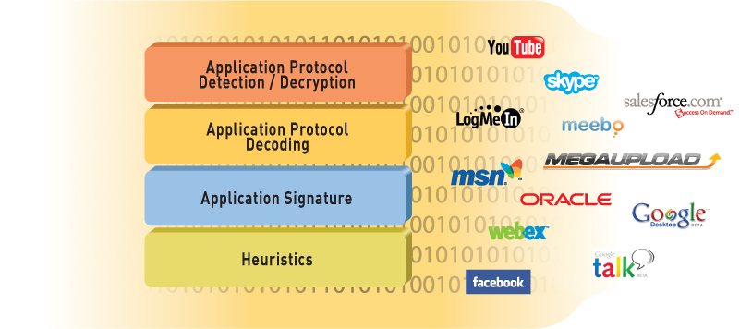
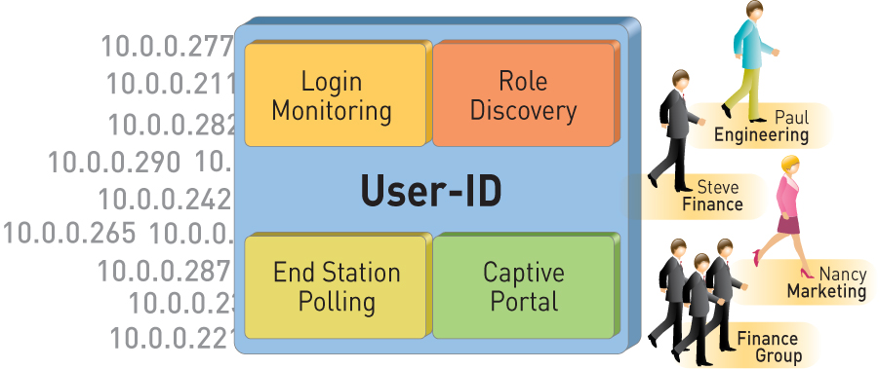
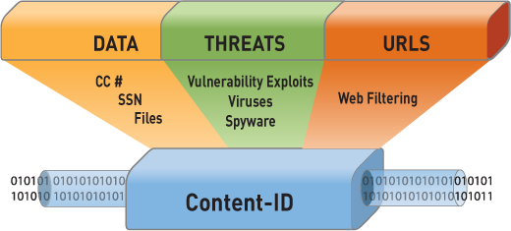
Identification Technologies Transform the Firewall
App-ID™
Identify the application
User-ID™
Identify the user
Content-ID™
Scan the content

Slide 19
App-ID: Comprehensive Application Visibility
Policy-based control more than 1200 applications distributed across five categories and 25 sub-categories
Balanced mix of business, internet and networking applications and networking protocols
3 - 5 new applications added weekly
App override and custom HTTP applications help address internal applications

Slide 20
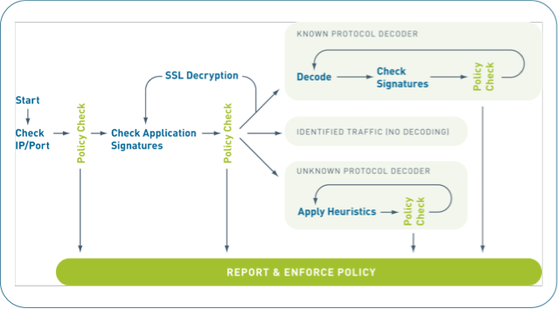

App-ID is Fundamentally Different
Always on, always the first action
Built-in intelligence
Sees all traffic across all ports
Scalable and extensible
Much more than just a signature….
© 2010 Palo Alto Networks. Proprietary and Confidential.
Page
Notes:
App-ID is smart = it automatically uses what ever mechanisms required to ID the traffic
App-ID is always on = no need to set policies on what to look for (outside of any-any-allow)
App-ID sees all traffic across all ports = no need to configure which port to look at for each application
App-ID is scalable = can add, new ID mechanisms to address changes in application landscape

Slide 21
User-ID: Enterprise Directory Integration
Users no longer defined solely by IP address
  Leverage existing Active Directory infrastructure without complex agent rollout
  Identify Citrix users and tie policies to user and group, not just the IP address
Understand user application and threat behavior based on actual AD username, not just IP
Manage and enforce policy based on user and/or AD group
Investigate security incidents, generate custom reports
Notes:
21
21

Slide 22
Content-ID: Real-Time Content Scanning
Detect and block a wide range of threats, limit unauthorized data transfer and control non-work related web surfing
Stream-based, not file-based, for real-time performance
  Uniform signature engine scans for broad range of threats in single pass
  Vulnerability exploits (IPS), viruses, and spyware (both downloads and phone-home)
Block transfer of sensitive data and file transfers by type
  Looks for CC # and SSN patterns
  Looks into file to determine type – not extension based
Web filtering enabled via fully integrated URL database
  Local 20M URL database (76 categories) maximizes performance (1,000’s URLs/sec)
  Dynamic DB adapts to local, regional, or industry focused surfing patterns
Notes:
22
22
22

Slide 23
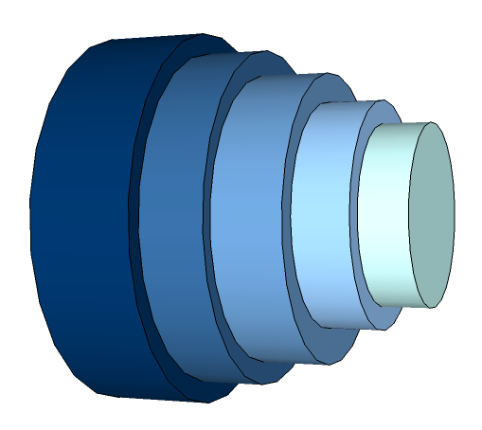

How the ID Technologies Work Together
What is the traffic and is it allowed? (App-ID) | Allowed for this specific user or group? (User ID) | What risks or threats are in the traffic? (Content ID)
Inbound
Full cycle threat prevention
Intrusion prevention
Malware blocking
Anti-virus control
URL site blocking
Encrypted and compressed files
Port Number
SSL
HTTP
GMail
Google Talk
Outbound
Data leakage control
Credit card numbers
Custom data strings
Document file types

Slide 24
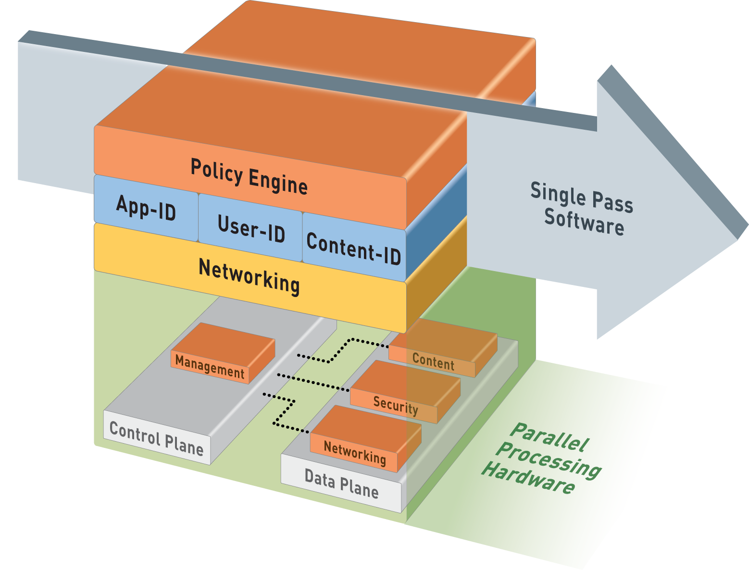
Single-Pass Parallel Processing™ (SP3) Architecture
Single Pass
Operations once per packet
  Traffic classification (app identification)
  User/group mapping
  Content scanning – threats, URLs, confidential data
One policy
Parallel Processing
Function-specific parallel processing hardware engines
Separate data/control planes
Up to 20Gbps, Low Latency

Slide 25
‘Secrets’ of the real NGFW
Parallel processing versus serial processing
  No dedicated engines per security feature
  Consistent syntax for all threat capabilities
App and User awareness at policy decision point
  Only allow those application you want to
    For well known users
  Actively reduce the threat vector
    Mariposa can’t behave as a trusted application
      Seen as Unkown-UDP
      Would have passed the traditional firewall
        Where single UDP packets, on an allowed port, will pass
    False positives are heavily reduced by tight application control

Slide 26
‘Secrets’ of the real NGFW – Cont.
Powerful Network Processors
  Cabable of handling ‘traditional’ firewall features
    Routing, NAT, QoS, …
Enhanced hardware
  Powerful and Optimized Security Processors
    No regular ‘data center’ processors
    Very high core density
    Very flexible
      No fixed iterations like with ASICs
    SSL, IPSec, Decompression Acceleration
Fast, but multi-purpose Content Scanning Engines
  Supporting consistent inspection syntax

Slide 27
In Other Words
Next-Generation Application Control and Threat Prevention Looks Like…

Slide 28









Full, Comprehensive Network Security
Clean the allowed traffic of all threats in a single pass
Only allow the
apps you need
Traffic limited to approved business use cases based on App and User
Attack surface reduced by orders of magnitude
Complete threat library with no blind spots
  Bi-directional inspection
  Scans inside of SSL
  Scans inside compressed files
  Scans inside proxies and tunnels
The ever-expanding universe of applications, services and threats

Slide 29
Firewall Remake – Real World Use
A remake, not inventing the wheel again
  Firewall’s are intended to enforce a ‘positive’ policy
    Facebook & Twitter posting are allowed for marketing people
    Facebook reading is allowed for known users
    Engineers have access to source code if PC has disk encryption on
    Apps that can tunnel other apps are not allowed at all
    Web-Browsing is allowed via the DSL line (with full threat scanning)
    SSL decryption is required for none financial and medical sites
    Enterprise Web 2.0 apps can be accessed via the MPLS cloud
    IM and WebEx are allowed, but without file or desktop sharing
    Streaming media is allowed, but rate limited to 256Kbps
    Remote access SSL-VPN traffic must be controlled by application
    …

Slide 30




















Transforming The Perimeter and Datacenter
Perimeter
Internet Datacenter
Enterprise Datacenter
Same Next-Generation Firewall, Different Benefits…

Slide 31
PAN-OS

Slide 32





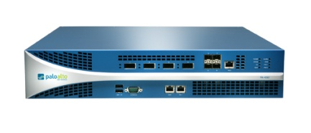


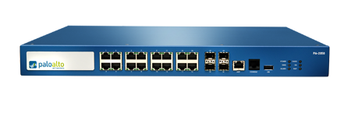
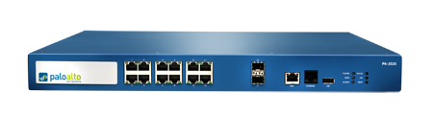
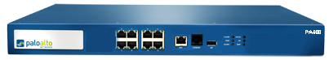
PAN-OS Core Firewall Features
Visibility and control of applications, users and content complement core firewall features
PA-5060
Strong networking foundation
  Dynamic routing (BGP, OSPF, RIPv2)
  Tap mode – connect to SPAN port
  Virtual wire (“Layer 1”) for true transparent in-line deployment
  L2/L3 switching foundation
  Policy-based forwarding
  IPv6 support
VPN
  Site-to-site IPSec VPN
  SSL VPN
QoS traffic shaping
  Max/guaranteed and priority
  By user, app, interface, zone, & more
  Real-time bandwidth monitor
Zone-based architecture
  All interfaces assigned to security zones for policy enforcement
High Availability
  Active/active, active/passive
  Configuration and session synchronization
  Path, link, and HA monitoring
Virtual Systems
  Establish multiple virtual firewalls in a single device (PA-5000, PA-4000, and PA-2000 Series)
Simple, flexible management
  CLI, Web, Panorama, SNMP, Syslog
PA-5050
PA-5020
PA-4060
PA-4050
PA-4020
PA-2050
PA-2020
PA-500
Notes:
32
32

Slide 33








Site-to-Site and Remote Access VPN
Site-to-site VPN connectivity
Remote user connectivity
Secure connectivity
  Standards-based site-to-site IPSec VPN
  SSL VPN for remote access
Policy-based visibility and control over applications, users and content for all VPN traffic
Included as features in PAN-OS at no extra charge

Slide 34
Traffic Shaping Expands Policy Control Options
Traffic shaping policies ensure business applications are not bandwidth starved
  Guaranteed and maximum bandwidth settings
  Flexible priority assignments, hardware accelerated queuing
  Apply traffic shaping policies by application, user, source, destination, interface, IPSec VPN tunnel and more
Enables more effective deployment of appropriate application usage policies
Included as a feature in PAN-OS at no extra charge

Slide 35
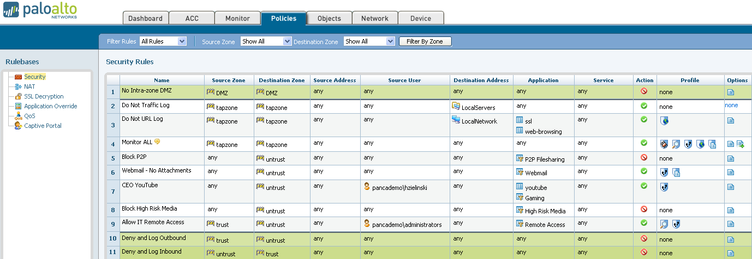
Flexible Policy Control Responses
Intuitive policy editor enables appropriate usage policies with flexible policy responses
Allow or deny individual application usage | Allow but apply IPS, scan for viruses, spyware
Control applications by category, subcategory, technology or characteristic | Apply traffic shaping (guaranteed, priority, maximum)
Decrypt and inspect SSL | Allow for certain users or groups within AD
Allow or block certain application functions | Control excessive web surfing
Allow based on schedule | Look for and alert or block file or data transfer

Slide 36
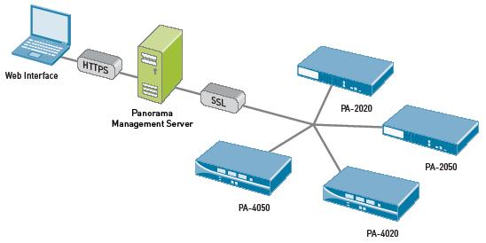
Enterprise Device and Policy Management
Intuitive and flexible management
  CLI, Web, Panorama, SNMP, Syslog
  Role-based administration enables delegation of tasks to appropriate person
Panorama central management application
  Shared policies enable consistent application control policies
  Consolidated management, logging, and monitoring of Palo Alto Networks devices
  Consistent web interface between Panorama and device UI
  Network-wide ACC/monitoring views, log collection, and reporting
All interfaces work on current configuration, avoiding sync issues
Notes:
36
36

Slide 37

Palo Alto Networks Next-Gen Firewalls
PA-5060
20 Gbps FW/10 Gbps threat prevention/4,000,000 sessions
4 SFP+ (10 Gig), 8 SFP (1 Gig), 12 copper gigabit
PA-5050
10 Gbps FW/5 Gbps threat prevention/2,000,000 sessions
4 SFP+ (10 Gig), 8 SFP (1 Gig), 12 copper gigabit
PA-5020
5 Gbps FW/2 Gbps threat prevention/1,000,000 sessions
8 SFP, 12 copper gigabit
PA-4060
10 Gbps FW/5 Gbps threat prevention/2,000,000 sessions
4 XFP (10 Gig), 4 SFP (1 Gig)
PA-4050
10 Gbps FW/5 Gbps threat prevention/2,000,000 sessions
8 SFP, 16 copper gigabit
PA-4020
2 Gbps FW/2 Gbps threat prevention/500,000 sessions
8 SFP, 16 copper gigabit
PA-2050
1 Gbps FW/500 Mbps threat prevention/250,000 sessions
4 SFP, 16 copper gigabit
PA-2020
500 Mbps FW/200 Mbps threat prevention/125,000 sessions
2 SFP, 12 copper gigabit
PA-500
250 Mbps FW/100 Mbps threat prevention/50,000 sessions
8 copper gigabit
Notes:
37

Slide 38







Flexible Deployment Options
Visibility
Transparent In-Line
Firewall Replacement
Application, user and content visibility without inline deployment
IPS with app visibility & control
Consolidation of IPS & URL filtering
Firewall replacement with app visibility & control
Firewall + IPS
Firewall + IPS + URL filtering

Slide 39
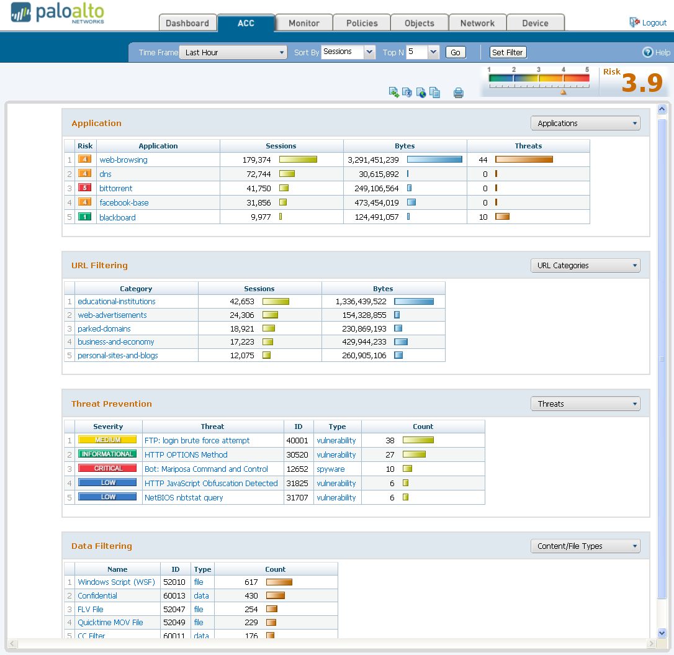
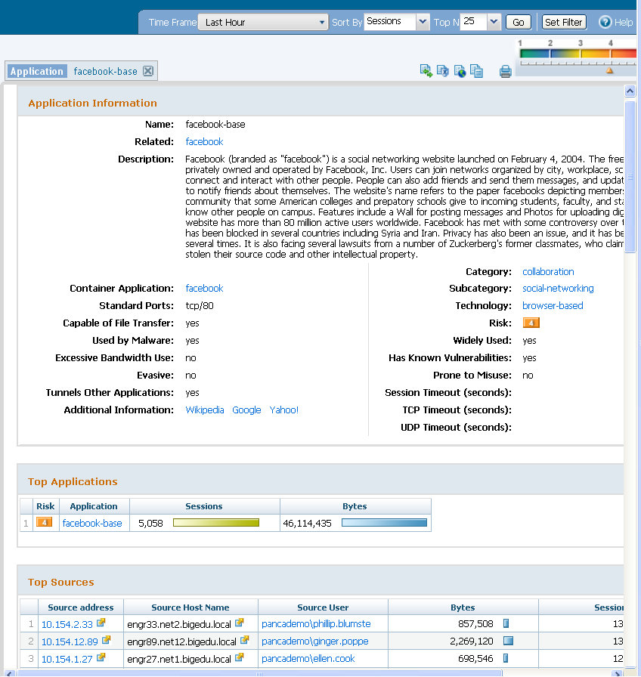
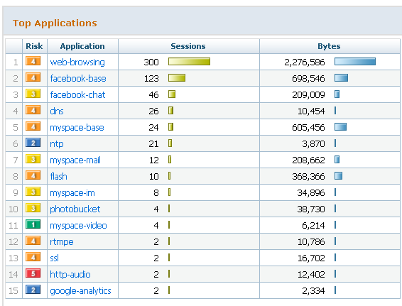
Comprehensive View of Applications, Users & Content
Application Command Center (ACC)
  View applications, URLs, threats, data filtering activity
Add/remove filters to achieve desired result
Filter on Facebook-base
Filter on Facebook-base
and user cook
Remove Facebook to
expand view of cook

Slide 40
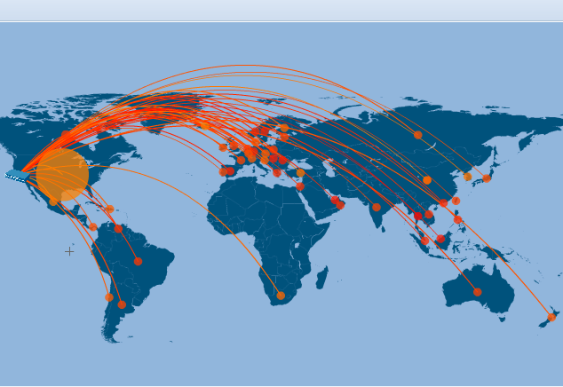
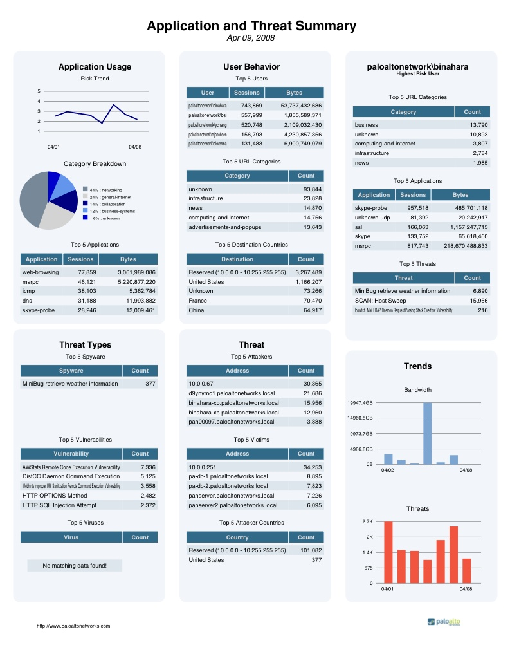
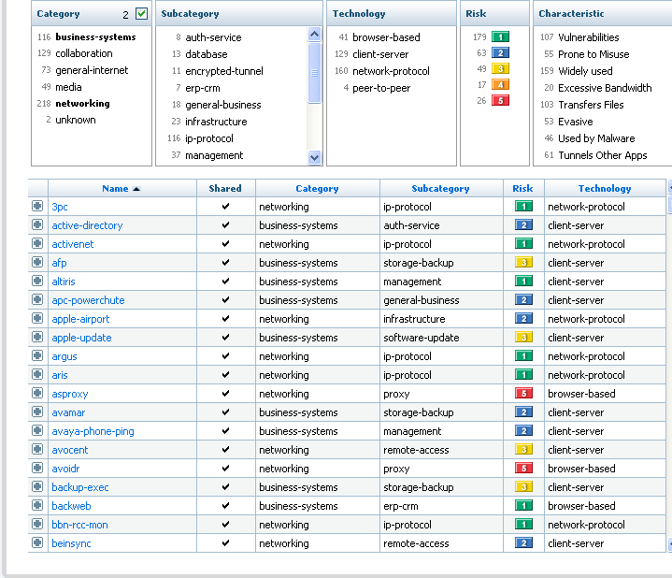
Enables Visibility Into Applications, Users, and Content

Slide 41
Management

Slide 42
Administrators and Scopes
Administrative accounts have scopes where their rights apply
  Device level accounts have rights over the entire device
  VSYS level accounts have rights over a specific virtual system
Administrators can be authenticated locally or through RADIUS
Administrators actions are logged in the configuration and system logs

Slide 43
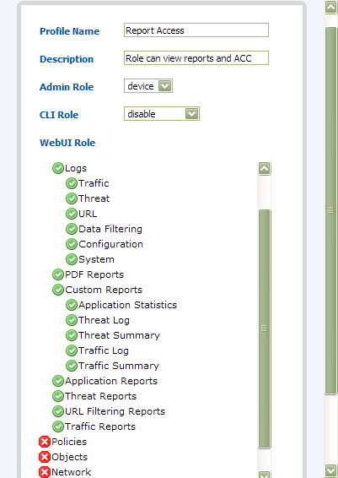
Role Based Administration
Built-in roles:
  Superuser
  Device Admin
  Read-Only Device Admin
  Vsys Admin
  Read-Only Vsys Admin
User Defined
  Based on job function
  Can be vsys or device wide
  Enable, Read-Only and Deny

Slide 44
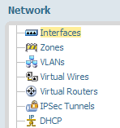
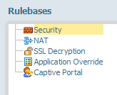
Dividing Access Control
VSYS – By object
RBA – By Task
Zone
VR / Vwire / VLAN
Interface
Tabs and Nodes
3 Levels of access
  No Access
  Read Only
  Read - Write
VSYS A
User Vwire
E1/3
E1/4
Inbound zone
Outbound zone
VSYS B
Default VR
E1/5
E1/6
Internet zone
LAN zone

Slide 45
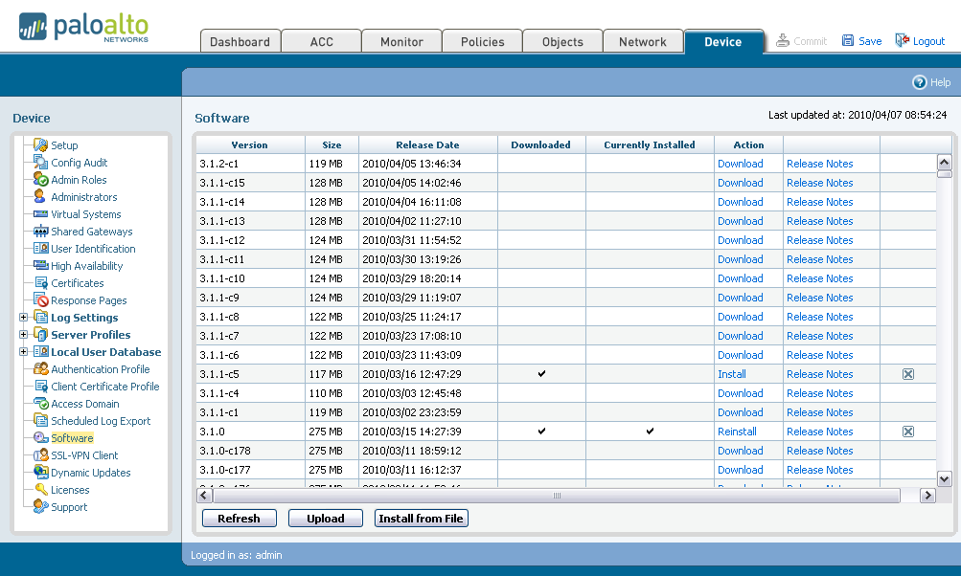
Upgrade PAN-OS
Check for New Software
Install Imported Software
Import Software
Notes:
45

Slide 46
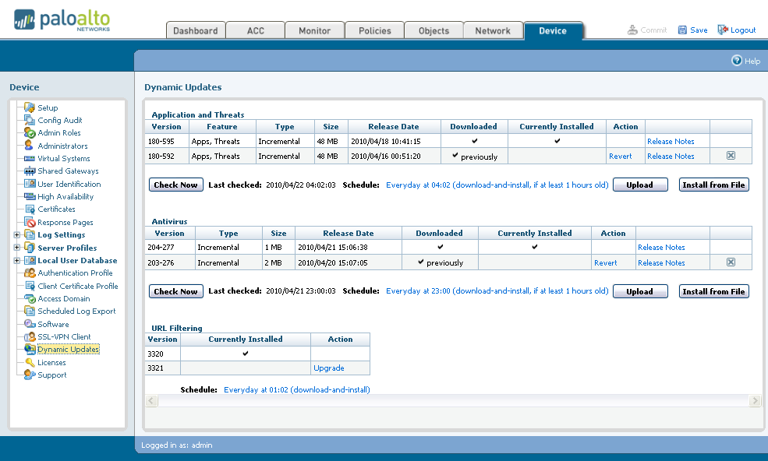
Update Applications, Threats, and Antivirus
Schedule and Check for New Content
Import Content
Install Imported Content
Schedule URL Update
Notes:
46

Slide 47
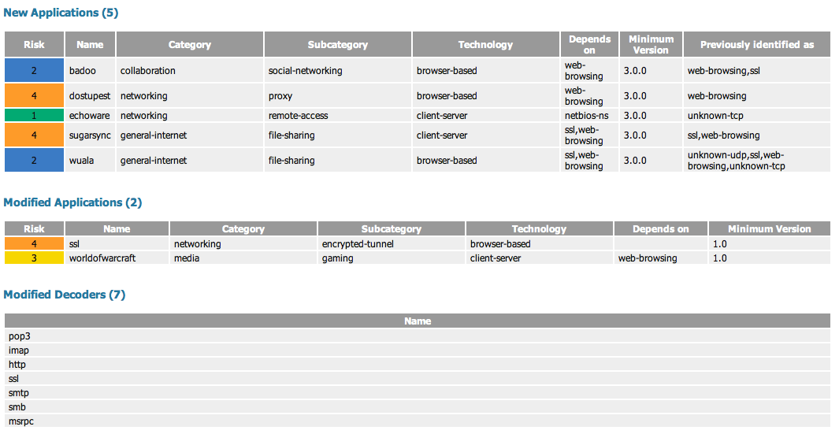
Weekly Content Update

Slide 48
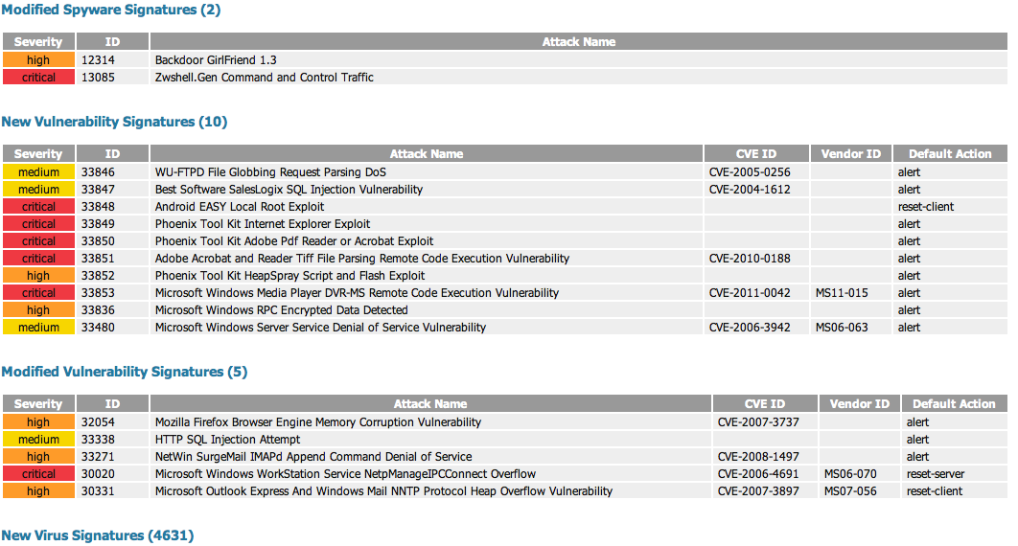
Weekly Content Update

Slide 49
Panorama 4.0
Revolution

Slide 50
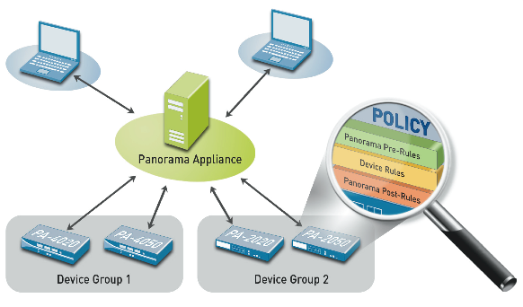
Centralized Visibility, Control and Management
Centralized policy management
Simplifying firewall deployments and updates
Centralized logging and reporting
Log Storage and High Availability
Notes:
50
50

Slide 51
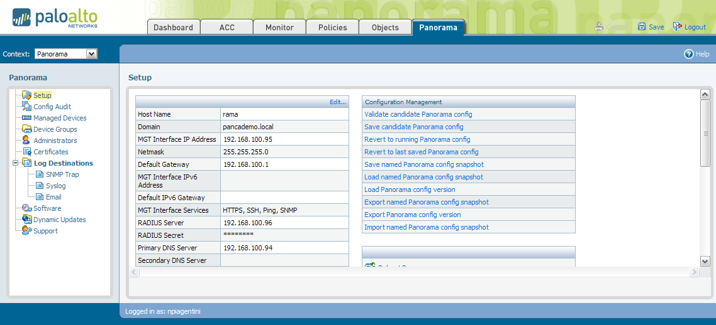
Panorama Interface
Uses similar interface to devices
“Panorama” tab provides management options for Panorama

Slide 52
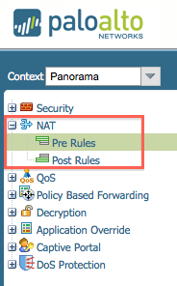
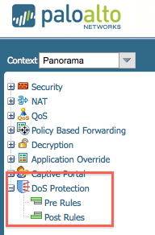
Panorama Full Rule Sharing

Slide 53
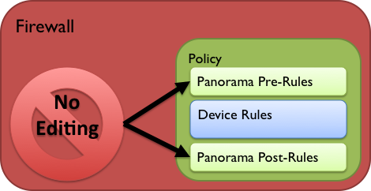
Shared Policy
Shared Rules
Panorama Policy rulebases are tied to Device Groups
No concept of global rules which apply to all managed devices
Pre/Post-rules cannot be edited inside firewall once pushed
  This is true even when in device specific context inside Panorama

Slide 54
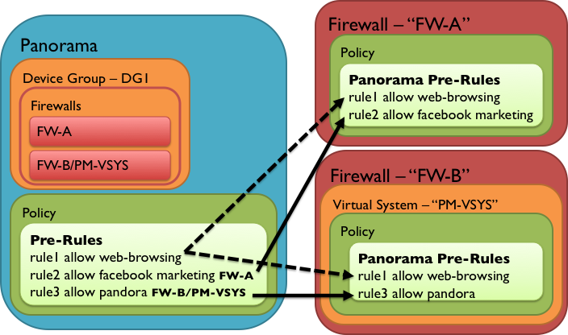
Component : Shared Policy
Targets
Rules can be “targeted” to individual devices
    Targets can be negated

Slide 55
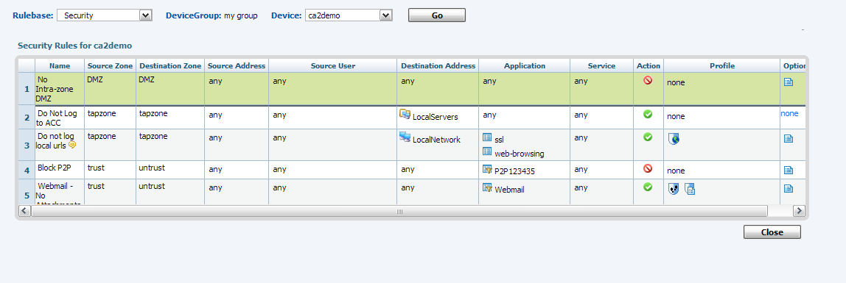
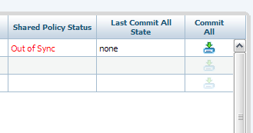
View and Commit
View combined policy for any device
Push and Commit device from Panorama managed devices view

Slide 56

Implementation : Comprehensive Config Audit
4.0 allows “Comprehensive Config Audit”
  Running vs. Candidate config on both Panorama and firewall
    Can be run on entire device group
Can help to avoid collisions or partially configured device commit
  Will indicate if device candidate config exists pre-Commit All

Slide 57
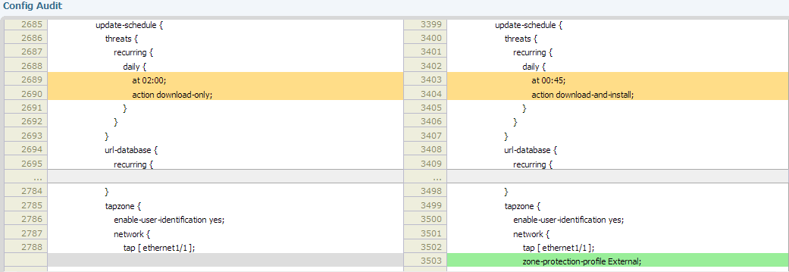
Configuration Auditing
The diff of the files is displayed
Color codes changes

Slide 58

Panorama Software Deployment
Managed Firewalls download content from Panorama
PANOS
Agents
Firewall
Content
Firewall
Panorama downloads Software from the Internet
  Content
  PANOS
  Agents
  SSL VPN client
Panorama
Firewall
Firewall

Slide 59
PANOS APIs

Slide 60
What is an API?
API, an abbreviation of Application Programming Interface, is a set of routines, protocols and tools for building software applications.
Good API’s should provide all the building blocks required for a programmer to assemble them into useful applications (….including documentation!)

Slide 61
PANOS provides 2 APIs for external system
REST API
  External system can manage device from remote
  Can show/set/edit/delete the device config
  Can poll ACC/Pre-defined/Custom report from the device
User-ID API
  User-ID integration with external system
  Can add/delete ip-username mapping info against UIA

Slide 62


REST API details
External system can connect to the device mgmt interface over SSL
External system can use REST API to see/change device config AND/OR get report data in XML format
API communication requires a key generated with admin ID and password info
SSL connection from external system is treated as general admin web access, so same source address restriction and timeout setting would be applied
Device Config
ACC/Report data
REST API over SSL
External System

Slide 63
REST API samples
Step 1 : generate Key for API communication
Key generation request example:
https://hostname/esp/restapi.esp?type=keygen&user=username&password=password
Key generation response example:
<response status="success">
<result>
<key>k7J335J6hI7nBxIqyfa62sZugWx7ot%2BgzEA9UOnlZRg=</key>
</result>
</response>
Step 2 : specify the type [config | report]

Slide 64
REST API samples – cont.
type = config
Specify the action [show | set | edit | delete]
  Set each config item in xpath
Xpath example
xpath=devices/entry/vsys/entry/rulebase/security
Example: Get security rulebase info from device config
https://hostname/esp/restapi.esp?type=config&action=show&key=keyvalue&
xpath=devices/entry/vsys/entry/rulebase/security
Example: Add config to device
https://hostname/esp/restapi.esp?type=config&action=set&key=keyvalue&xpath=xpath-value&element=element-value

Slide 65
REST API samples – cont.
type = report
  Specify the reporttype [dynamic | predefined | custom ]
  Specify reportname
  Can specify the period OR starttime & endtime *optional
Example : Get Application Top 5 data from ACC
https://hostname/esp/restapi.esp?type=report&reporttype=dynamic&
reportname=top-app-summary&period=last-hour&topn=5&key=keyvalue
Example : Get the “top-attackers-summary” data from pre-defined report
https://hostname/esp/restapi.esp?type=report&reporttype=predefined&
reportname=top-attackers-summary&key=keyvalue

Slide 66

User-ID API details
External system uses SSL/TLS to connect to User-ID Agent
External system can send user login/logout event info to Agent in XML
Agent sends response back in XML
External system can keep connection up to send continuous data OR it can close the connection as necessary
Each User-ID Agent can have up to 100 connections simultaneously
User & Group Info
User-to-IP Mapping
User-ID API
SSL/TLS
User-ID Agent
External

Slide 67
User-ID API samples - XML Request
<uid-message>
<version>1.0</version>
<type>update</type>
<payload>
<login>
<entry name=”domain\uid1” ip=”10.1.1.1”>
<entry name=”domain\uid2” ip=”10.1.1.2”>
<entry name=”domain\uid3” ip=”10.1.1.3”>
</login>
<logout>
<entry name=”domain\uid4” ip=”10.1.1.4”>
</logout>
</payload>
</uid-message>

Slide 68
User-ID XML API use case:
Virtualization Security Visibility

Slide 69
The Situation Today: Islands of Management
VM Management
Network Management
Workloads
Networks
Gap
No data synchronization
No visibility across functions
Manual, error-prone
Policies
Security Management

Slide 70
Palo Alto Networks Eliminates the Gap
VM Management
Network Management
Workloads
Networks
Palo Alto Networks VM-ID
Cross-functional visibility & Control
Real-time
Fully automated
Policies
Security Management

Slide 71
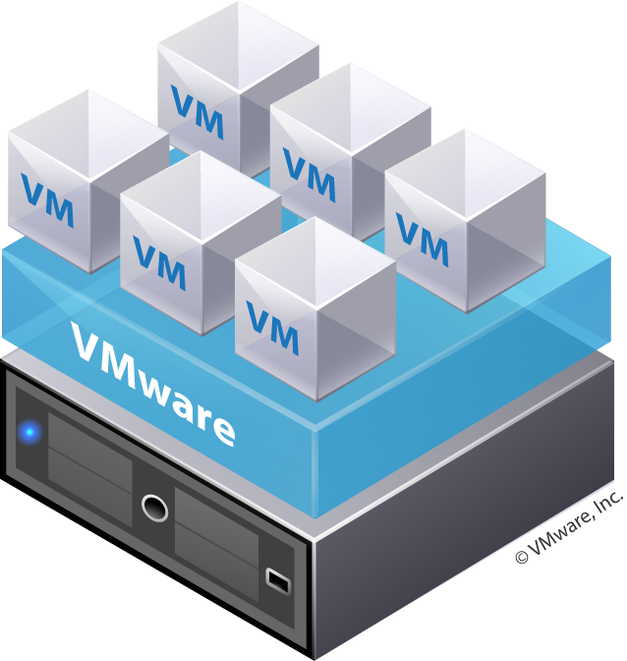
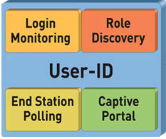
VM-ID vSphere Polling
vSphere
vSphere
1. User-ID Agent Polls vCenter or ESX(i)
2. Agent Publishes VM Mapping
3. VM Visibility in ACC
4. Dynamic VM Adds/Moves auto-sync
Binds VM->IP
Report on VM and User->VM Activity
vCenter

Slide 72
PAN-OS 4.0: A Significant Milestone

Slide 73
PAN-OS 4.0
App-ID
  Custom App-IDs for unknown protocols
  App and threats stats collection
  SSH tunneling control (for port forwarding control)
  6,000 custom App-IDs
User-ID
  Windows 2003 64-bit, Windows 2008 32- and 64-bit Terminal Server support; XenApp 6 support
  Client certificates for captive portal
  Authentication sequence flow
  Strip x-forwarded-for header
  Destination port in captive portal rules
Threat Prevention & Data Filtering
Behavior-based botnet C&C detection
PDF virus scanning
Drive by download protection
Hold-down time scan detection
Time attribute for IPS and custom signatures
DoS protection rulebase
URL Filtering
Container page filtering, logging, and reporting
Seamless URL activation
“Full” URL logging
Manual URL DB uploads (weekly)

Slide 74
SSH Tunneling
Detect Local forwarding, Remote forwarding, X11
New App-ID called SSH-Tunnel
Shell access, SCP, SFTP will be identified as SSH, not SSH-Tunnel
Only SSH V2
Configuration option to allow/block a session that cannot be decrypted
Key based auth, if SSH allowed in policy and decrypt is on, client retry will succeed.

Slide 75
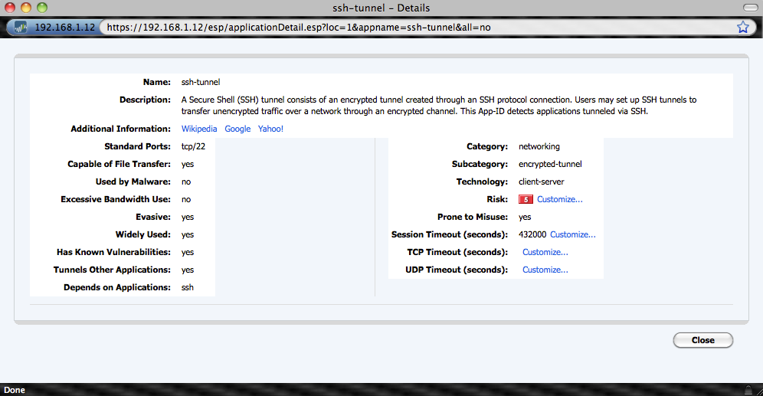
SSH-tunnel

Slide 76
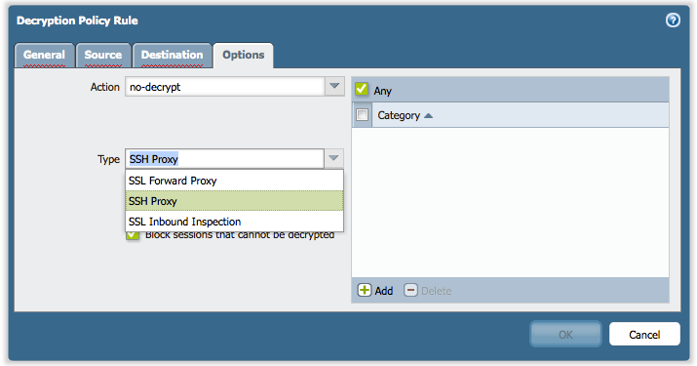
Decryption Rule base

Slide 77

Custom App-ID – Unknown traffic

Slide 78


Bot-net detection
Bot-net detection
  Advanced heuristics to detect botnets
  Collates info from Traffic, Threat, URL logs to identify potential infected hosts
  Reports generated daily with suspected hosts and confidence level
  Uses unknown-tcp/udp, IRC and HTTP traffic(malware, recently registered, etc to identify.

Slide 79
Drive-by-download Protection
  Introducing a new file blocking profile action “continue”
  If user attempts to download a file through the browser or a file download is attempted by the website automatically and the traffic matches the file blocking rule, a page with be presented to the user indicating that file transfer is being attempted
  The page has a “continue” button. If the user clicks it, file transfer will continue
  Idea is to warn the user about file transfer transaction – in drive-by-downloads, the downloading of malicious files happens without user intervention
© 2010 Palo Alto Networks. Proprietary and Confidential

Slide 80
Time-attribute for IPS Signatures +
Custom Combination Signatures
  Introducing ability to configure time-attribute for brute-force signatures
    How many times brute-force event is detected per unit of time
  Previously for custom vulnerability signatures, we allowed creating signature using protocol decoder context only
  Now, introducing ability to create custom “combination” signatures i.e., taking individual spyware or vulnerability threat ids and grouping them into one custom signature
  Allows user to create more specific custom signatures
  Time-attribute configuration is needed for the custom signatures to make them meaningful
© 2010 Palo Alto Networks. Proprietary and Confidential

Slide 81


Custom Signature – Combination & Time Attr.

Slide 82
Blackhole malicious traffic
  Introducing a new action “block-ip” for spyware/vulnerability signatures, Zone protection profile and DoS rule base (new functionality)
  Idea is to block all future traffic from a malicious host once the traffic from the host triggers a security condition
  The action requires 2 attributes to be configured
    Time (in secs) for which the traffic will be blocked
    In what way traffic will be blocked: Based on Source-IP or source-and-destination IP
© 2010 Palo Alto Networks. Proprietary and Confidential

Slide 83


Custom Signature with Block IP and Duration

Slide 84
DoS Protection
  Extends our existing DoS protections that are currently configurable on a per-zone basis
  Introducing DoS protection rule base that provides a fine granularity of what traffic (based on source/destination zone, source/destination IP, service, user) needs to be covered with DoS Protection
  DoS protection profiles are defined separately that include thresholds for TCP/UDP/Other-IP/ICMP and also session limit. Two types of profiles are supported:
    Aggregate: Thresholds apply to all traffic
    Classified: Thresholds apply either on basis of source IP, destination IP or a combination of both.
  One Aggregate and classified profile can be applied to a DoS protection rule
© 2010 Palo Alto Networks. Proprietary and Confidential

Slide 85


DoS Protection

Slide 86

DoS Protection Rule Base

Slide 87
PAN-OS 4.0
Networking
  Active/Active HA
  HA enhancements (link failover, next-hop gateway for HA1, more)
  IPv6 L2/L3 basic support
  DNS proxy
  DoS source/dest IP session limiting
  VSYS resource control (# rules, tunnels, more)
  Country-based policies
  Overlapping IP support (across multiple VRs)
  VR to VR routing
  Virtual System as destination of PBF rule
  Untagged subinterfaces
  TCP MSS adjustment
NetConnect SSL-VPN
  Password expiration notification
  Mac OS support (released w/ PAN-OS 3.1.4)
GlobalProtect™*
  Windows XP, Vista, 7 support (32- and 64-bit support)
  Host profiling
  Single sign-on
* Requires optional GlobalProtect device license

Slide 88
PAN-OS 4.0
New UI Architecture
  Streamline policy management workflow
  Rule tagging, drag-n-drop, quick rule editing, object value visibility, filtering, and more
Panorama
Extended config sharing (all rulebases, objects & profiles shared to device)
Dynamic log storage via NFS
Panorama HA
UAR from Panorama
Exportable config backups
Comprehensive config audit
Management
FQDN-based address objects
Configurable log storage by log type
Configurable event/log format (including CEF for ArcSight)
Configuration transactions
SNMPv3 support
Extended reporting for VSYS admins (scheduler, UAR, summary reports, email forwarding)
PCAP configuration in UI

Slide 89
GlobalProtect™
Securing Users and Data in an Always Connected World

Slide 90









Introducing GlobalProtect
Users never go “off-network” regardless of location
All firewalls work together to provide “cloud” of network security
How it works:
  Small agent determines network location (on or off the enterprise network)
  If off-network, the agent automatically connects the laptop to the nearest firewall via SSL VPN
  Agent submits host information profile (patch level, asset type, disk encryption, and more) to the gateway
  Gateway enforces security policy using App-ID, User-ID, Content-ID AND host information profile

Slide 91






A Modern Architecture for Enterprise Network Security
malware
exploits
botnets
Establishes a logical perimeter that is not bound to physical limitations
Users receive the same depth and quality of protection both inside and out
Security work performed by purpose-built firewalls, not end-user laptops
Unified visibility, compliance and reporting

Slide 92







GlobalProtect Topology
Portal
Gateway
Gateway
Gateway
1
4
3
2
Client
Client attempts SSL connection to Portal to retrieve latest configuration
Client does reverse DNS lookup per configuration to determine whether on or off network (e.g. lookup 10.10.10.10 and see if it resolves to internal.paloalto.local)
If external, client attempts to connect to all external gateways via SSL and then uses one with quickest response
SSL or IPSec tunnel is established and default routes inserted to direct all traffic through the tunnel for policy control and threat scanning
Gateway
© 2011 Palo Alto Networks. Proprietary and Confidential.
92

Slide 93

Global Protect

Slide 94

Global Protect

Slide 95

Global Protect

Slide 96

Global Protect

Slide 97

Global Protect

Slide 98
PA-5000 Series: Preview of the Fastest
Next-Generation Firewall

Slide 99


PA-5000 Series
A picture is worth a thousand words…
RJ45 Ports
SFP Ports
SFP+ Ports
Hot Swap Fan Tray
Dual AC/DC Hot Swap Supplies
Dual 2.5 SSD with Raid 1
Note: Systems ship with
single,120GB SSD

Slide 100
PA Architecture
Quad-core mgmt
High speed logging and route update
Dual hard drives
Signature Match HW Engine
Stream-based uniform sig. match
Vulnerability exploits (IPS), virus, spyware, CC#, SSN, and more
Signature Match
RAM
Signature Match
RAM
RAM
RAM
RAM
RAM
RAM
RAM
Core 1
Core 2
RAM
10Gbps
10Gbps
RAM
Core 3
Core 4
SSD
CPU
1
CPU
2
...
CPU
12
RAM
CPU
1
CPU
2
...
CPU
12
RAM
CPU
1
CPU
2
...
CPU
12
RAM
SSD
RAM
RAM
RAM
Control Plane
SSL
IPSec
De-Compress.
SSL
IPSec
De-Compress.
SSL
IPSec
De-Compress.
80 Gbps switch fabric interconnect
20 Gbps QoS engine
Security Processors
High density parallel processing for flexible security functionality
Hardware-acceleration for standardized complex functions (SSL, IPSec, decompression)
20Gbps
Flow
control
Route, ARP, MAC lookup
NAT
Network Processor
20 Gbps front-end network processing
Hardware accelerated per-packet route lookup, MAC lookup and NAT
QoS
Switch
Fabric
Switch Fabric
Data Plane
Notes:
100
100
100
03/05/07

Slide 101
PA-5000 Series Architecture
Highly available mgmt
High speed logging and route update
Dual hard drives
Signature Match HW Engine
Stream-based uniform sig. match
Vulnerability exploits (IPS), virus, spyware, CC#, SSN, and more
Signature Match
RAM
Signature Match
RAM
RAM
RAM
40+ processors
30+ GB of RAM
Separate high speed data and
control planes
20 Gbps firewall throughput
10 Gbps threat prevention throughput
4 Million concurrent sessions
RAM
RAM
RAM
RAM
Quad-core
CPU
RAM
10Gbps
10Gbps
RAM
HDD
CPU
1
CPU
2
...
CPU
12
RAM
CPU
1
CPU
2
...
CPU
12
RAM
CPU
1
CPU
2
...
CPU
12
RAM
HDD
RAM
RAM
RAM
Control Plane
SSL
IPSec
De-Compress.
SSL
IPSec
De-Compress.
SSL
IPSec
De-Compress.
80 Gbps switch fabric interconnect
20 Gbps QoS engine
Security Processors
High density parallel processing for flexible security functionality
Hardware-acceleration for standardized complex functions (SSL, IPSec, decompression)
20Gbps
Flow
control
Route, ARP, MAC lookup
NAT
Network Processor
20 Gbps front-end network processing
Hardware accelerated per-packet route lookup, MAC lookup and NAT
QoS
Switch
Fabric
Switch Fabric
Data Plane
Notes:
101
101
101
03/05/07

Slide 102
Q&A

Slide 103
Thank you

Slide 104
Thank You

