Slide 1
Passwords are dead! Behavior is the New authentication
Laszlo G. Jobbagy
Regional Sales Director
BalaBit Europe
Tallin, Estonia
2016

Slide 2
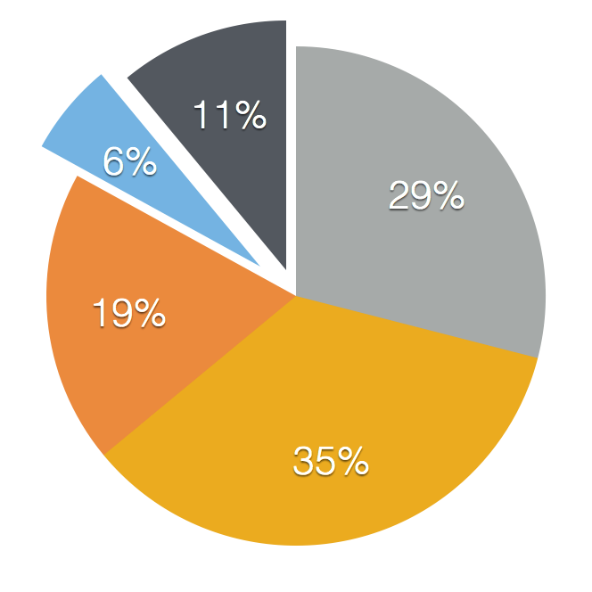
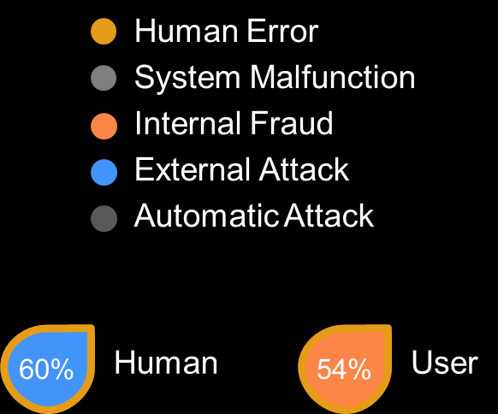

Slide 3
EXISTING CONTROLS FOR SECURING ACCOUNTS
PASSWORDS
MULTI-FACTOR AUTHENTICATION
PRIVILEGED IDENTITY / ACCESS MANAGEMENT
PRIVILEGED SESSION MONITORING
Notes:
But is there a better way to do it? Let’s sum up the different methods we use for securing the most important accounts in a system.
Obviously, we still have passwords. Things have improved somewhat with the emergence of personal password managers but they are still not used widely enough to make a large difference.
Multi-factor authentication became much easier since 2004, mostly as a result of everyone now having an internet-connected computer in their pockets.
For the most important, often shared accounts, we implemented privileged identity & access management to make sure we can manage access to certain special roles in a fine-grained way.
And also we came up with tools to actually monitor what people do after the log in.
These tools mitigated some of the risks around accounts that have access to sensitive or valuable data, however they all still depend on a fundamental step: authenticating the user before permitting him or her access to the account.

Slide 4
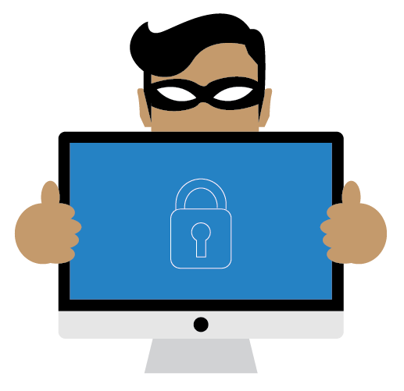
What if the attacker already has access?
Notes:
And the scariest one of all: what happens if the attacker already has access. I am not here to spread some good old FUD, but all surveys and whitepapers, including Verizon’s DBIR or Ponemon’s annual survey and numerous papers from analysts say that attackers tend to linger for a long time in a network before their actions are detected. If you are managing a large enough IT infrastructure, there are good chances that somebody already has access who shouldn’t. Strengthening the authentication probably won’t help against them either.

Slide 5
Figure 8. When was the breach discovered?
Unable to determine
20%
More than two years after the incident
15%
Within two years after the incident
18%
Within one year after the incident
21%
Within six months after the incident
16%
Within three months after the incident
5%
Within one month after the incident
3%
Within one week after the incident
2%
0%
5%
10%
15%
20%
25%

Slide 6
THEN PASSWORDS ARE DEAD!
Notes:
Passwords are dead! A bold statement, isn’t it?
<pause>
Well, I’m not the first one to say it. Bill Gates has used the same phrase over a decade ago, in 2004. What he meant by that at that time is that they wanted to get rid of passwords and switch to use supposedly stronger methods like smartcards, keyfobs or biometrics like fingerprint scanning.
Yet, passwords are still in widespread use. Multifactor authentication is still a challenge to implement. Deploying a smartcard-based authentication scheme is still not trivial.
However, I am not going to talk about multi-factor authentication or which smartcard is the best choice. Rather I'd like to talk about the weaknesses of authentication in general and what we can do to overcome those problems..
Let me start with a short, personal story first.

Slide 7
ONE-OFF AUTHENTICATION VS CONTINUOUS AUTHENTICATION
Activity A
Activity B
Activity C
Login
Login
Logout
CONTINUOUS
AUTHENTICATION
Activity
A
Activity
B
Activity
C
Single line of
authentication
Notes:
The fundamental problem with authentication is that in most cases it only happens once, at the beginning of the session. You have one single chance to tell friend from foe, be that a simple password, some form of multi-factor authentication or access facilitated by a password management system. Once the authentication is performed, the user of the account is free to do whatever he or she wants until the end of the session, which can be days later.
What if, instead of a single authentication at the beginning of the sessions we could ensure the authenticity of the user continuously throughout his or her entire workflow?

Slide 8
HOW CAN WE IMPLEMENT CONTINUOUS AUTHENTICATION WITHOUT DRIVING YOUR EMPLOYEES MAD?
Notes:
There’s one big challenge: achieving this without driving your people crazy. You could certainly ask them to re-type their passwords every five minutes or confirm their presence through some smartphone app. Hell, you could even put a security guard behind them to watch over their shoulders and decide if they are doing something malicious.
While all this could work, it would seriously compromise the efficiency of their work and would definitely drive your people crazy.

Slide 9
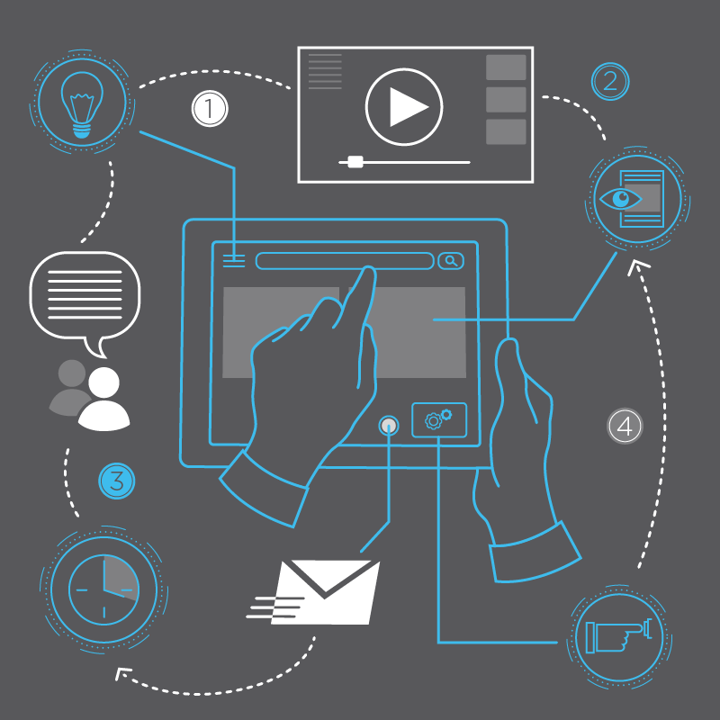
BEHAVIOR IS THE SOLUTION
Notes:
The solution is to monitor and analyze the behavior of the users continuously.
We are not only interested whether the user could authenticate at the beginning of the session. We also need to follow them in real time and check everything what they do and see if their behavior matches what we would expect.
In a sense, we do post a guard to watch all their sessions. But this is not a person rather a system that finds the suspicious activities that give away attackers.
But what is behavior analytics and how does it work?

Slide 10
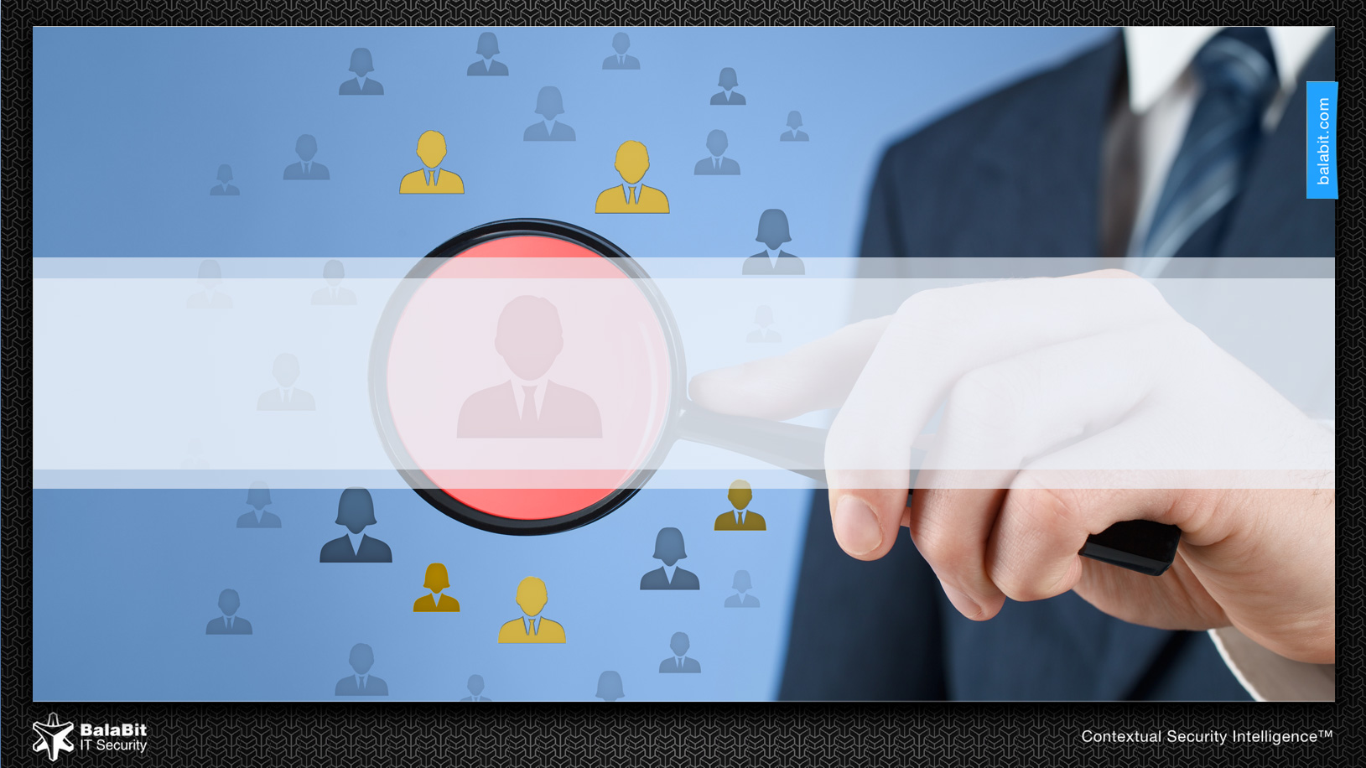
BlindSpotter

Slide 11
Behavior is the new authentication?
“
BEHAVIOR IS THE INTERNALLY COORDINATED RESPONSES OF WHOLE LIVING ORGANISMS TO INTERNAL AND/OR EXTERNAL STIMULI.
“
Daniel A. Levitis, PhD in Integrative Biology
Notes:
First, let's define what behavior is. We humans are great at understanding and recognizing patterns in how things happen around us. We perceive our world, then identify patterns which we later remember and can use in our everyday life to make decisions. And we also use the same approach all the time to identify people – or even pets.
Let me illustrate behavioral authentication with another personal example. My parents have two cats. They are lovely creatures, but the big problem with them is that they look completely the same. They’ve had them for 8 years now and I still can’t tell them apart just by looking at them. There’s a solution though: one of them loves when one scratches her ears and the other hates it. So my solution is to wait until they come closer and start scratching their ears gently. If the resulting behavior, the response to the stimulus, is purring, I can be pretty sure that it’s Lizzie. If the result is angry hissing, the authentication failed and I know it’s Rosie.

Slide 12
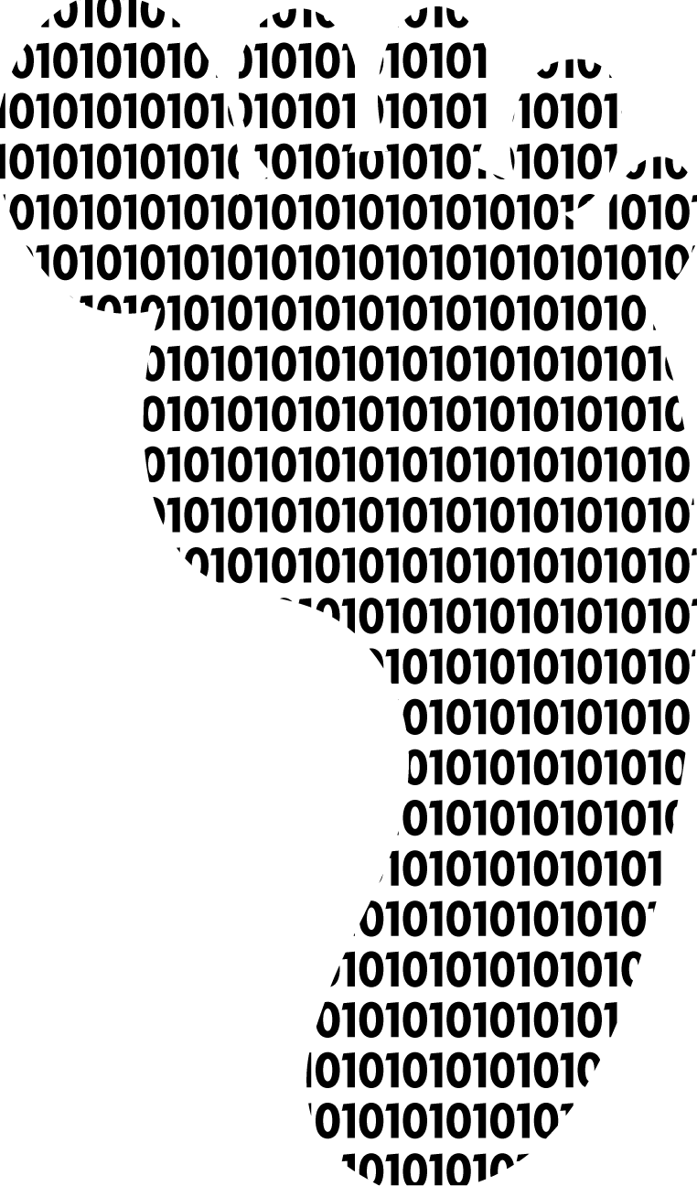
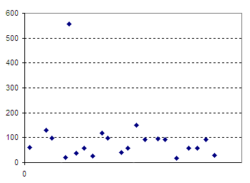
User Behavior Analytics (UBA) At the first glance
Gather users’ digital footprints
Build a baseline for „normal” behavior
Number of used hosts
Identify unusual activities in real-time
Act immediately to prevent data breaches
Users

Slide 13
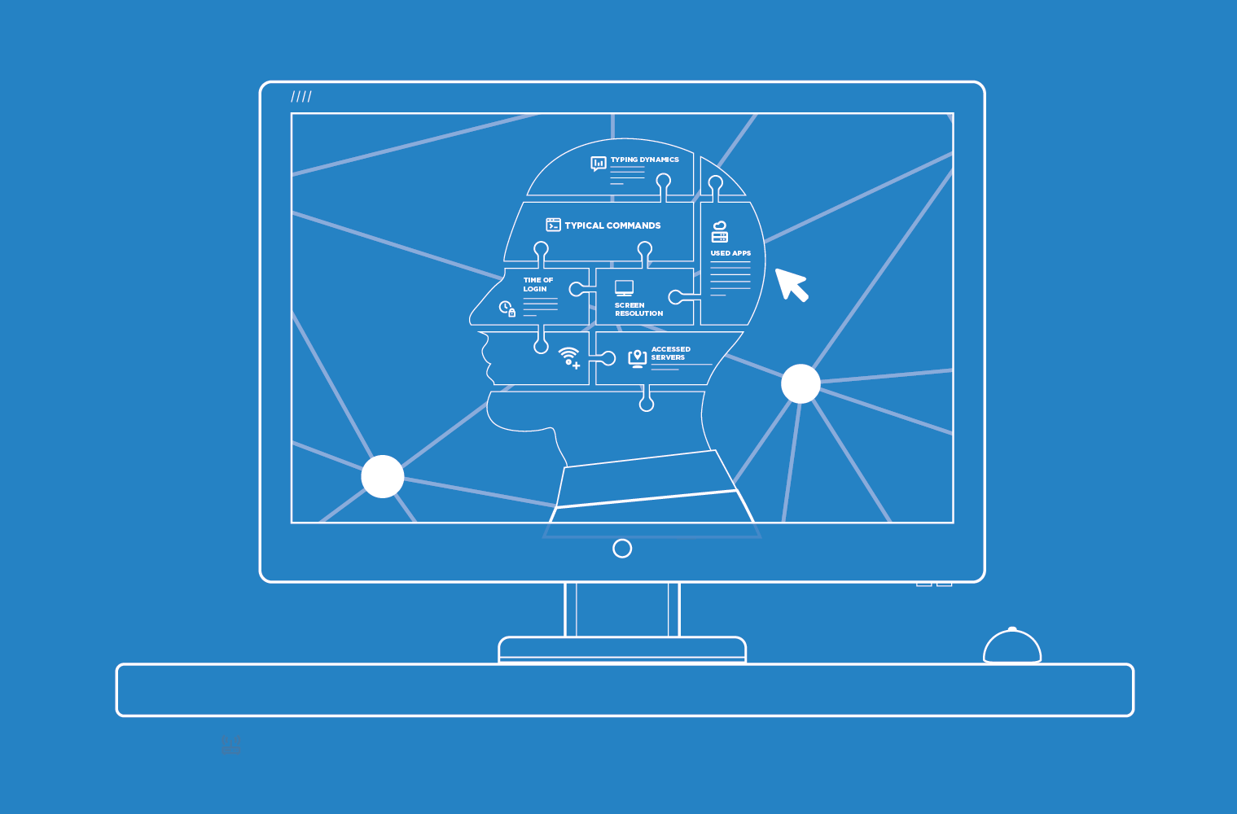
WHAT IS DIGITAL BEHAVIOR?
Time of login
Accessed servers
Typing dynamics
Used apps
Screen resolution
Typical commands
Notes:
Digital behaviour is different, but is also similar. As we do our work everyday, we leave traces of information around in system & application logs, we leave our digital fingerprints around in different systems.
<click>
accessed servers, applications, commands, how we type and when we do these are typical.
As over the years I could learn which behavior identifies which cat, elements of one’s digital behavior can also be stored.

Slide 14
What else could be elements of digital behavior?
Unusual amount of activity
Unusual source IP
Mouse movement
Unusual access to various kind of data
Unusual range of accessed servers and applications
Unusual commands

Slide 15
Using behavioral analysis
IT Security can detect hijacked accounts
The misuse of privileges
Identify system accounts used by humans and personal accounts used by scripts
Can Support security decisions by showing how people really use the system
Notes:
Detect hijacked accounts
An administrator's computer got compromised through a phishing attack and the attacker is using the admin's credentials to access the systems to steal data. The activities of the attacker differ significantly from what the admin would usually do: a large number of connections are initiated to probe for available services, the activity is performed outside of normal office hours and the attacker accesses servers that the admin very rarely does. The admin's activities are logged in various systems and access to the most critical servers are monitored and controlled by an SCB. The security team needs to be alerted of this highly unusual and thus suspicious activity and the admin's account should be blocked until the investigation is done.
During an APT-style attack, the attacker used an exploit to elevate her privileges and gain access to an admin account. He is using that account to steal sensitive data (eg. credit card numbers) from the company. The admin account is rarely used directly and only for well-defined procedures. Using that account for the steps required to get that data leaves traces in the logs and this unusual activity should be detected in real-time as it starts happening and the security team should be alerted to prevent the actual data breach from happening.
Detect misuse of privileges
The data stored on the company's servers is extremely valuable for competitors. A disgruntled administrator might be bribed to steal a portion of that data and share it with outsiders, believing that her admin privileges might allow her to erase her traces and not be discovered. Even though the admin has to have access to the servers that store the sensitive information, she rarely accesses it and even then, she never really touches the data itself. Accessing that server is normal for this admin and copying data off that server is not an unusual thing per se, but it is something that this admin never really does. The security team needs to be alerted about this activity so that the malicious insider can be identified and further data breaches can be prevented.
With great power comes great responsibility -- but this admin is not really up for the job. He uses his privileges to spy on his colleagues and the clients for personal reasons: he is prying on transaction information of high-profile clients, e-mails of the group CEO and the admin's attractive colleague he has a crush on. This is a huge legal liability and the worker's representatives want assurance that such a nightmare scenario cannot happen.
Detect system accounts used by humans and personal accounts used by scripts
The administrator automated some tasks he has to perform regularly (eg. backup the database, restart certain services overnight etc.). This is all fine and helps him do his job more efficiently, however, for easy deployment, he used his own credentials. This a potential security risk as that means that if the attacker finds a way to hack the script (and such ad-hoc developments are often prone to trivial attacks like SQL or shell injections) or gains access to the stored credentials the script is using, he now gains access to all the services the admin has access to. It is possible to distinguish between human and automated activity and if an account known to belong to a human is found to be user by scripts, the security team should be notified to be able to take action before this security hole turns into a security breach.
If an account is set up to be used solely by automated scripts, we want to recognize if we suddenly detect human activity there as it might mean that the attacker gained access to that account and is now using that to steal data.
Support your security decisions by seeing how your administrators really use the system
In large organizations the phenomenon known as "privilege creep" is a big issue: the people, especially admins get more and more privileges to be able to perform the new tasks they get over the time. After a while they have access to way more services than what they actually need access to and it is almost impossible to figure out which of these rights are really needed. That's a security issue and Blindspotter has to help by giving an overview of how different services are being used within the company.

Slide 16
It IS Anomaly detection, not patterns
Usual login time
Unusual login time
Notes:
UBA does not rely on a description of “known bad” behavior, does not need an updated list of activities that are considered suspicious. Instead it detects deviations from what is normal for a given user. Such anomalies might mean that the account was stolen: an attacker does very different things than what a user normally does – logs in to lots of servers to look around, issues different commands or uses different applications or accesses different data. Or it might be the same user but she’s up to something malicious, hence the change in her behavior.
How do we detect such anomalies?
Users in IT environment leave digital footprints in the system. You can collect these footprints to build up a behavior profile. UBA collects these digital footprints from different sources: not just logs but user activities and session recordings as well. After having the data we use special data science algorithms to add more value to the information.
One example: we check the typical login times: eg. this user usually logs in during the workday and after dinner. It would be interesting if he logged in at, say, 12 AM.
Other algorithms include:
Unusual source IP
Unusual OS or screen resolution
Unusual amount of activities
Unusual access to various kind of data
Unusual commands or applied software
What is important to note that neither of these analyses requires you to set up and maintain patterns of “known bad” behavior. UBA identifies “normal” behavior and detects deviations from that normal baseline.

Slide 17
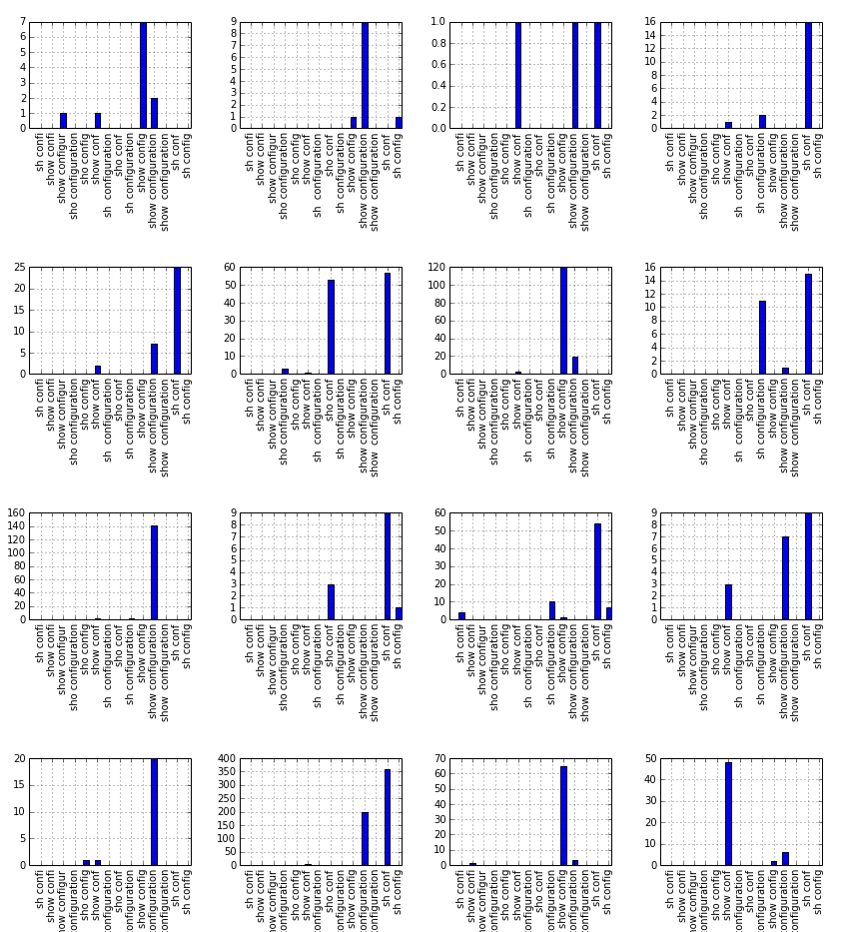
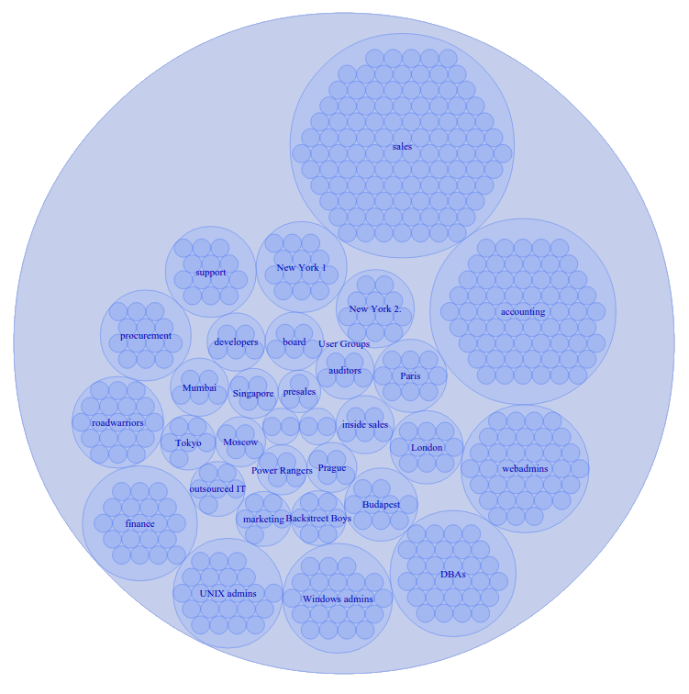
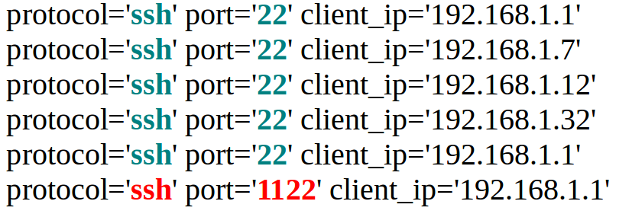
The Math BEHIND UBA
time distributions: kernel density analysis
association rule learning / frequent itemset mining
recommender systems & clustering
text analysis

Slide 18
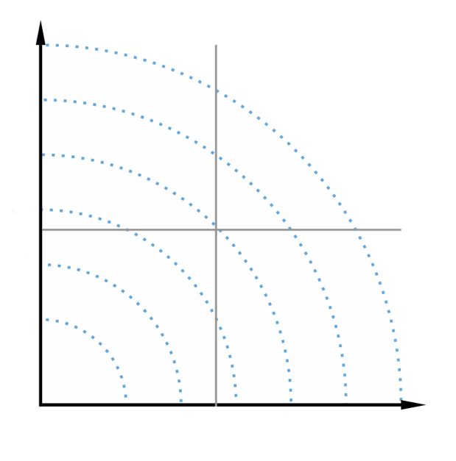
UBA Doesn’t classify, BUT prioritizes!
DBA runs a query on the customers’ table
DBA restarts Oracle
Trainee logs in at 11PM
Trainee logs in at 9AM
Deviation
Priority list based on risk factor
and deviation
Risk factor
Notes:
To optimize the work of analysts, UBA prioritizes the potential incidents it sees in the network.
Imagine events being plotted on a coordinate system. The X axis denotes the inherent risk of a user: a senior sysadmin or a CEO is inherently more risky than a trainee or a guest account: they can do more damage. The Y axis is for deviation: how much a given activity differs from what’s usual for a user.
Business-as-usual activities of low-risk users are not interesting but highly unusual things done by high-risk users are something you want to know about: if your senior sysadmin starts to copy the entire user database in the middle of the night logging in from an IP in China that's highly unusual and it's more interesting than when your receptionist checks his email at 7AM from his own desktop computer!
With UBA you are able to categorize these events and highlight the most suspicious events where the risk factor and the deviation level are high.
UBA creates a priority list, displayed on a dashboard, for security analysts to investigate the most suspicious events to make sure that they spend their time optimally.

Slide 19
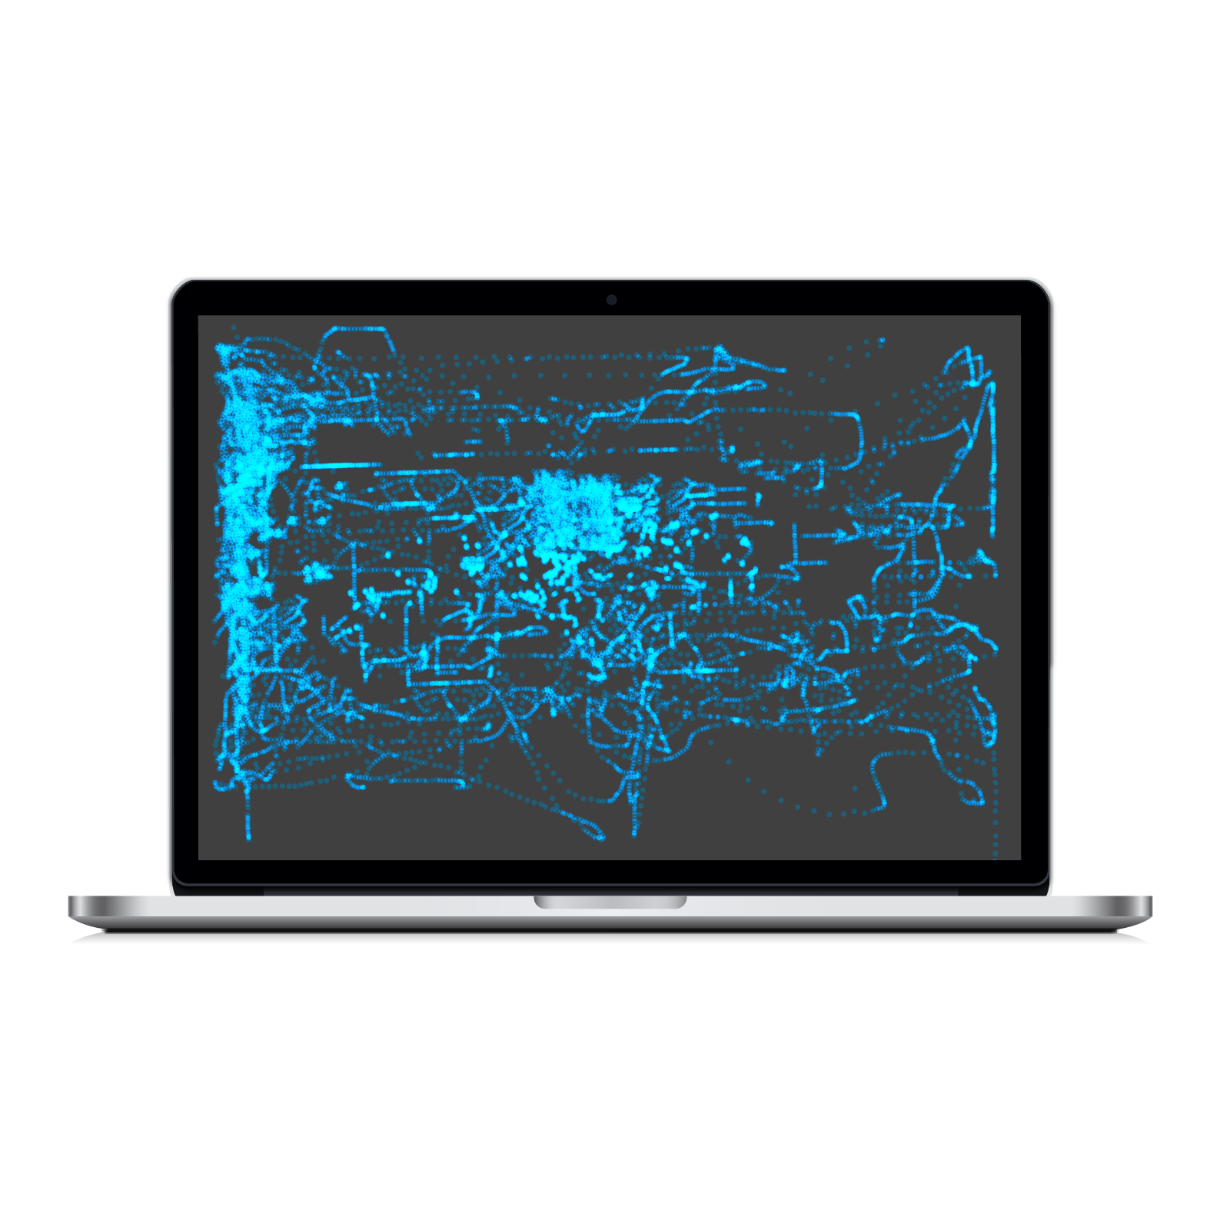
BEHAVIOR IS THE NEW AUTHENTICATION!
Mouse movement analysis
Keystroke dynamics analysis
INHERENCE
Something you are
Notes:
In authentication, biometrics is a high precision factor that we can use when entering a sensitive area.
We can do something similar in UBA by looking at ones mouse movements and keystroke patterns.
Again, these mouse movements are not specifically made in order to authenticate, rather it is using your keystrokes and mouse movements that you would do anyway to perform your job.

Slide 20
If passwords are at least half dead
Authentication does not defend against those attackers, who have valid credentials (malicious insiders, APT attacks)
Advantages of user behavior analytics:
Continuous
Detect changes and anomalies
Biometrics is very hard to imitate
Notes:
To sum it up, authentication & thus our existing controls over privileged accounts do not defend against targeted attackers or insiders.
Behaviour can be a missing link, the next step if those fail us. It is:
- continuous
- detect changes and anomalies
- can be a form of biometrics without having to do specific authentication
steps.

Slide 21
Almost the End
CRIME SCENE eCSI OFFICERS ONLY

Slide 22
